Slide 1

CS 161: Fundamentals of Artificial Intelligence
Adversarial Search
Notes:
Please retain proper attribution, including the reference to ai.berkeley.edu. Thanks!

Slide 2
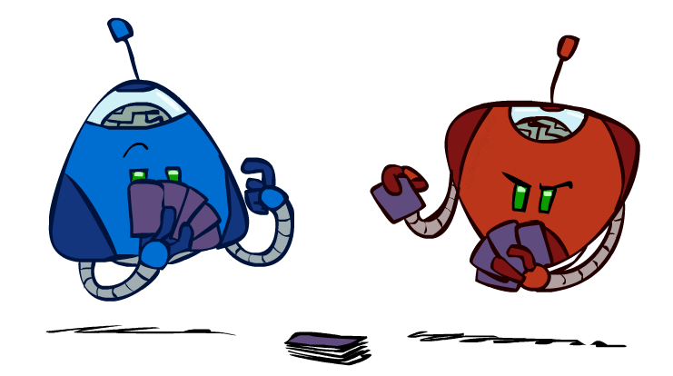
Types of Games
Many different kinds of games!
Axes:
Deterministic or stochastic?
One, two, or more players?
Zero sum?
Perfect information (can you see the state)?
Want algorithms for calculating a strategy (policy) which recommends a move from each state

Slide 3
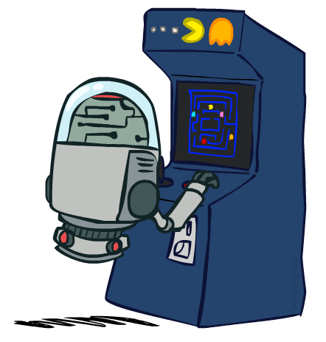
Deterministic Games
Many possible formalizations, one is:
States: S (start at s₀)
Players: P={1...N} (usually take turns)
Actions: A (may depend on player / state)
Transition Function: SxA → S
Terminal Test: S → {t,f}
Terminal Utilities: SxP → R
Solution for a player is a policy: S → A

Slide 4
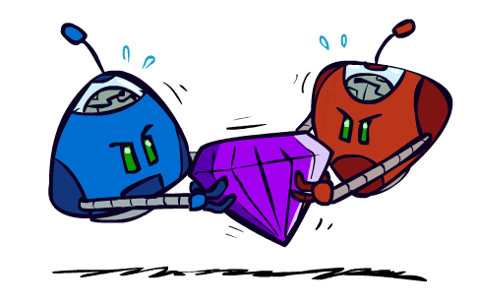
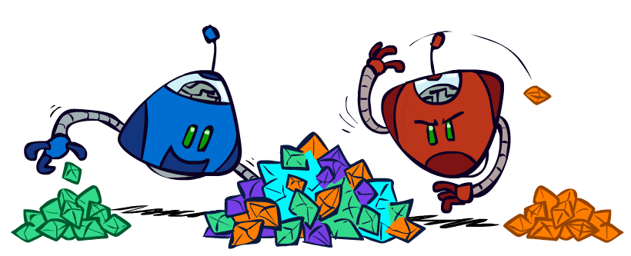
Zero-Sum Games
Zero-Sum Games
Agents have opposite utilities (values on outcomes)
Lets us think of a single value that one maximizes and the other minimizes
Adversarial, pure competition
General Games
Agents have independent utilities (values on outcomes)
Cooperation, indifference, competition, and more are all possible
More later on non-zero-sum games

Slide 5
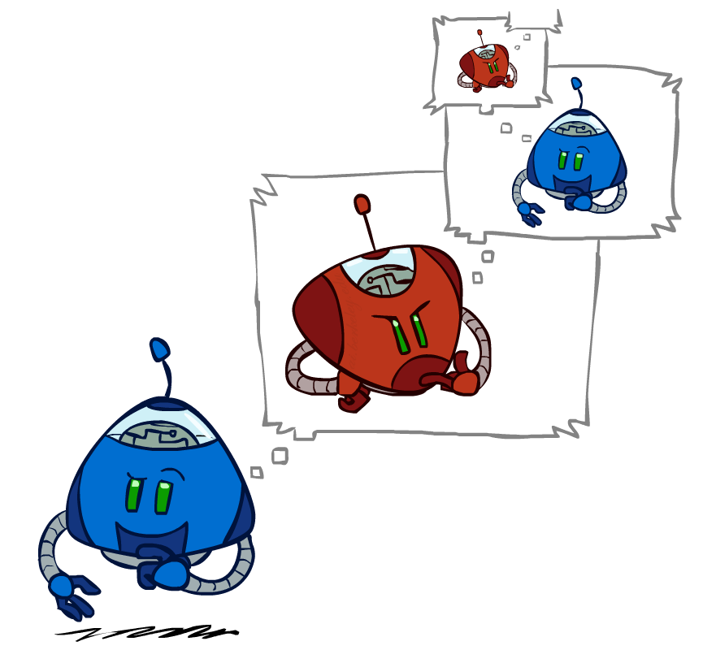
Adversarial Search

Slide 6
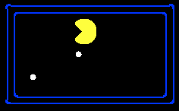
Single-Agent Trees
8
2
0
…
2
6
…
4
6

Slide 7
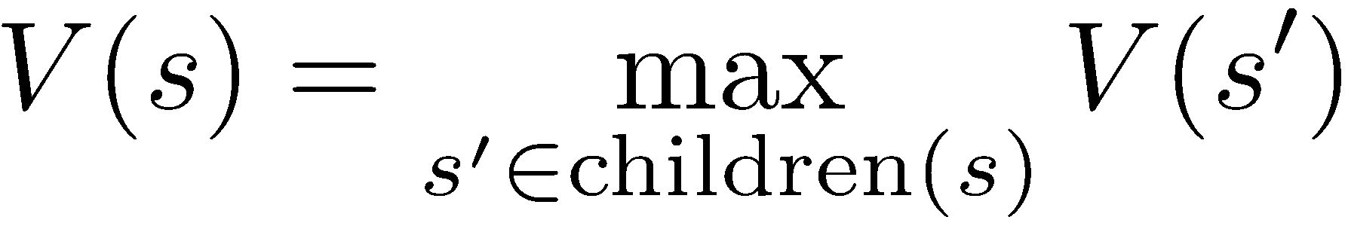
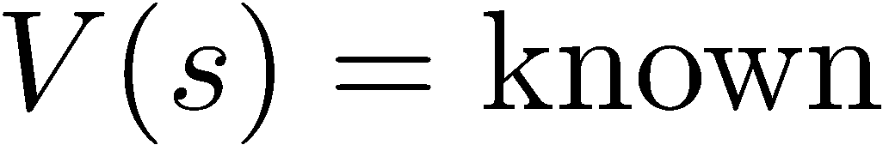
Value of a State
Value of a state: The best achievable outcome (utility) from that state
Non-Terminal States:
8
2
0
…
2
6
…
4
6
Terminal States:

Slide 8

Adversarial Game Trees
-20
-8
…
-18
-5
…
-10
+4
-20
+8

Slide 9
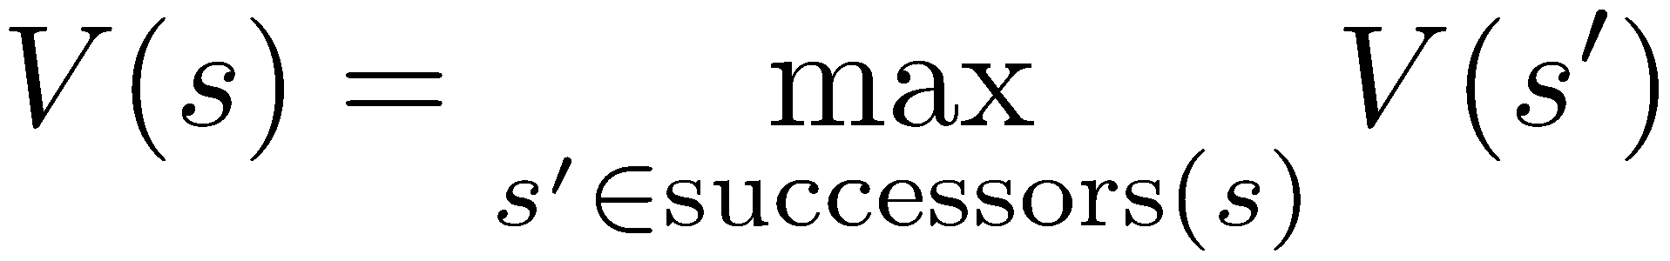
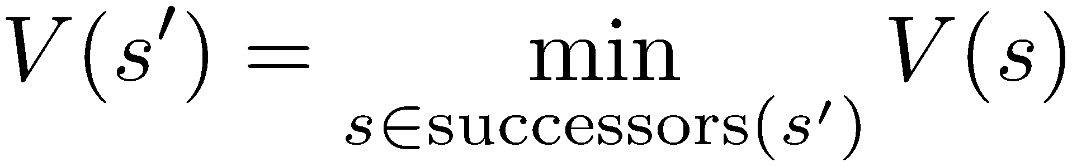
Minimax Values
States Under Agent’s Control:
States Under Opponent’s Control:
-8
-5
-10
+8
Terminal States:

Slide 10

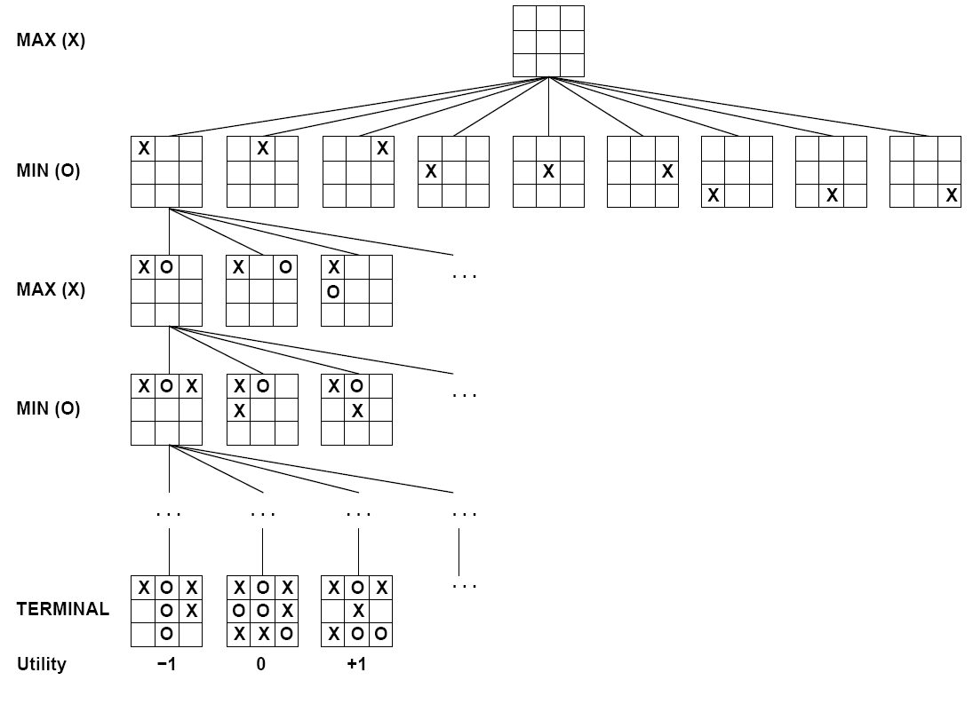

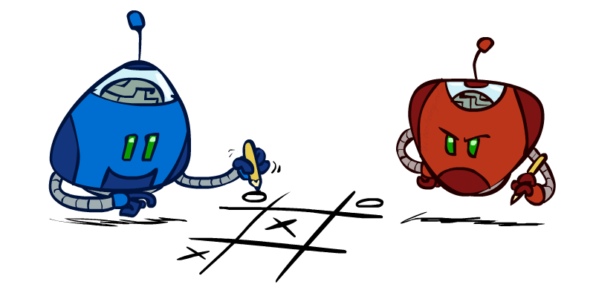
Tic-Tac-Toe Game Tree

Slide 11
Adversarial Search (Minimax)
Deterministic, zero-sum games:
Tic-tac-toe, chess, checkers
One player maximizes result
The other minimizes result
Minimax search:
A state-space search tree
Players alternate turns
Compute each node’s minimax value: the best achievable utility against a rational (optimal) adversary
Minimax values: computed recursively
5
max
2
5
min
8
2
5
6
Terminal values: part of the game

Slide 12
Minimax Implementation
def max-value(state):
initialize v = -∞
for each successor of state:
v = max(v, min-value(successor))
return v
def min-value(state):
initialize v = +∞
for each successor of state:
v = min(v, max-value(successor))
return v

Slide 13
Minimax Implementation (Dispatch)
def value(state):
if the state is a terminal state: return the state’s utility
if the next agent is MAX: return max-value(state)
if the next agent is MIN: return min-value(state)
def max-value(state):
initialize v = -∞
for each successor of state:
v = max(v, value(successor))
return v
def min-value(state):
initialize v = +∞
for each successor of state:
v = min(v, value(successor))
return v
Notes:
Pick an order for two reasons: sequential processor and pruning

Slide 14
Minimax Example
3
12
8
2
4
6
14
5
2

Slide 15
Minimax Efficiency
How efficient is minimax?
Just like (exhaustive) DFS
Time: O(b^{m})
Space: O(bm)
Example: For chess, b ≈ 35, m ≈ 100
Exact solution is completely infeasible
But, do we need to explore the whole tree?

Slide 16
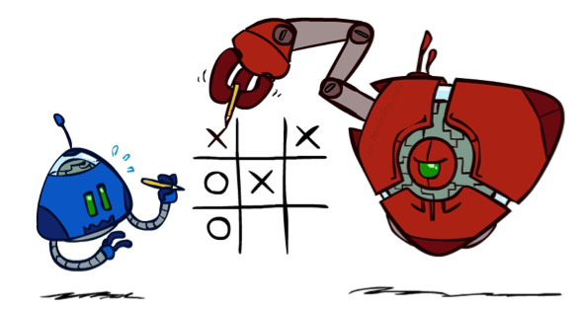
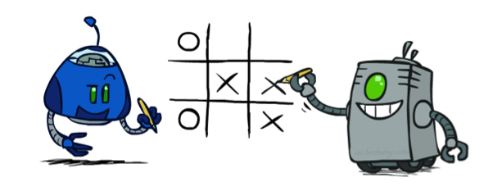
Minimax Properties
max
min
10
10
9
100
Optimal against a perfect player. Otherwise?
[Demo: min vs exp (L6D2, L6D3)]

Slide 17

Resource Limits

Slide 18
Resource Limits
Problem: In realistic games, cannot search to leaves!
Solution: Depth-limited search
Instead, search only to a limited depth in the tree
Replace terminal utilities with an evaluation function for non-terminal positions
Example:
Suppose we have 100 seconds, can explore 10K nodes / sec
So can check 1M nodes per move
α-β reaches about depth 8 – decent chess program
Guarantee of optimal play is gone
More plies makes a BIG difference
Use iterative deepening for an anytime algorithm
max
4
-2
4
min
-1
-2
4
9
?
?
?
?

Slide 19


Depth Matters
Evaluation functions are always imperfect
The deeper in the tree the evaluation function is buried, the less the quality of the evaluation function matters
An important example of the tradeoff between complexity of features and complexity of computation
[Demo: depth limited (L6D4, L6D5)]

Slide 20
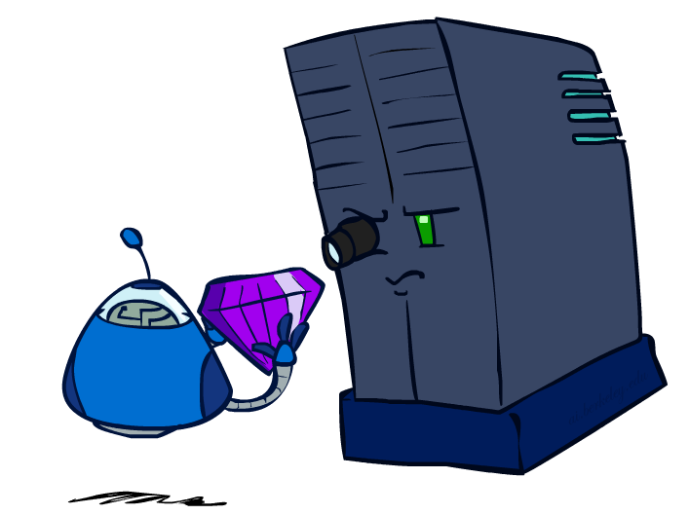
Evaluation Functions

Slide 21
Evaluation Functions
Evaluation functions score non-terminals in depth-limited search
Ideal function: returns the actual minimax value of the position
In practice: typically weighted linear sum of features:
e.g. f₁(s) = (num white queens – num black queens), etc.

Slide 22
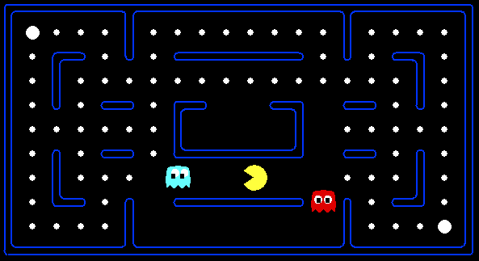




Evaluation for Pacman
[Demo: thrashing d=2, thrashing d=2 (fixed evaluation function), smart ghosts coordinate (L6D6,7,8,10)]

Slide 23
Why Pacman Starves
A danger of replanning agents!
He knows his score will go up by eating the dot now (west, east)
He knows his score will go up just as much by eating the dot later (east, west)
There are no point-scoring opportunities after eating the dot (within the horizon, two here)
Therefore, waiting seems just as good as eating: he may go east, then back west in the next round of replanning!

Slide 24
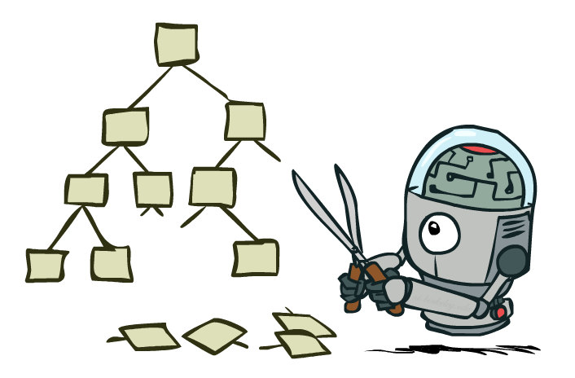
Game Tree Pruning

Slide 25
Minimax Example
3
12
8
2
4
6
14
5
2

Slide 26
Minimax Pruning
3
12
8
2
14
5
2

Slide 27
Alpha-Beta Pruning
General configuration (MIN version)
We’re computing the MIN-VALUE at some node n
We’re looping over n’s children
n’s estimate of the childrens’ min is dropping
Who cares about n’s value? MAX
Let a be the best value that MAX can get at any choice point along the current path from the root
If n becomes worse than a, MAX will avoid it, so we can stop considering n’s other children (it’s already bad enough that it won’t be played)
MAX version is symmetric
MAX
MIN
a
MAX
MIN
n

Slide 28
Alpha-Beta Implementation
α: MAX’s best option on path to root
β: MIN’s best option on path to root
def max-value(state, α, β):
initialize v = -∞
for each successor of state:
v = max(v, value(successor, α, β))
if v ≥ β return v
α = max(α, v)
return v
def min-value(state , α, β):
initialize v = +∞
for each successor of state:
v = min(v, value(successor, α, β))
if v ≤ α return v
β = min(β, v)
return v
Notes:
Pick an order for two reasons: sequential processor and pruning

Slide 29
Alpha-Beta Pruning Properties
This pruning has no effect on minimax value computed for the root!
Values of intermediate nodes might be wrong
Important: children of the root may have the wrong value
So the most naïve version won’t let you do action selection
Good child ordering improves effectiveness of pruning
With “perfect ordering”:
Time complexity drops to O(b^{m/2})
Doubles solvable depth!
Full search of, e.g. chess, is still hopeless…
This is a simple example of metareasoning (computing about what to compute)
max
min
10
10
0

Slide 30
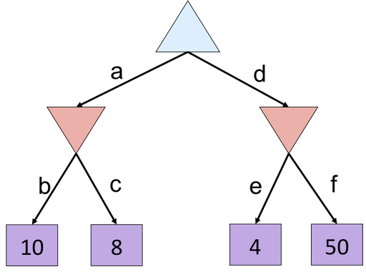
Alpha-Beta Quiz

Slide 31
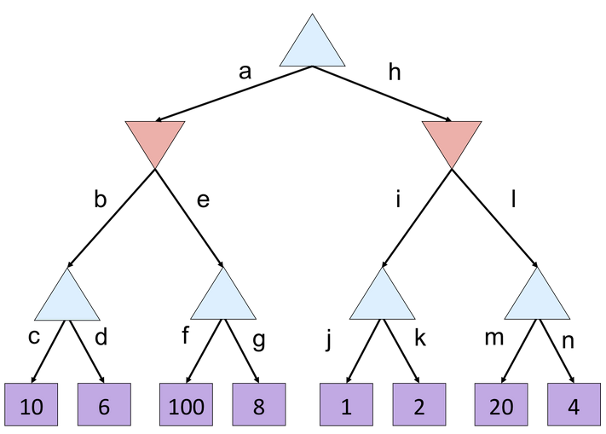
Alpha-Beta Quiz 2

Slide 32
Iterative Deepening
Iterative deepening uses DFS as a subroutine:
Do a DFS which only searches for paths of length 1 or less. (DFS gives up on any path of length 2)
If “1” failed, do a DFS which only searches paths of length 2 or less.
If “2” failed, do a DFS which only searches paths of length 3 or less.
….and so on.
Why do we want to do this for multiplayer games?
Note: wrongness of eval functions matters less and less the deeper the search goes!
b
…

